Slide 1
Interventions to Protect Your Medical Staff
Elizabeth (Beth) Korinek, M.P.H.
Chief Executive Officer
CPEP – Center for Personalized Education for Professionals

Slide 2
CPEP: Who are We?
Mission-driven 501(c)(3) non-profit supported by hospital systems, insurers and others
Mission: To promote clinical excellence, ethical care, and patient safety by enhancing the competence and professionalism of healthcare professionals
Founded in 1990 by leading healthcare organizations in CO
COPIC, CMS, CHA, UCSOM and more
Receive no funding from licensing fees
Serve more than 750 clinicians per year
Physicians, PAs, APNs, and many other professions
Participants come from US and Canada
Thank You!

Slide 3
CPEP Board of Directors
11 clinician board members
3 non-clinician members
Christopher Awtrey, MD, MBA – Intermountain Health
Diana Breyer, MD – UCHealth
Brian Davidson, MD, MBA – Cigna
Shawn Dufford, MD, MBA – Memorial Health System (MS)
CPEP Board Immediate Past President
Shauna Gulley, MD, MBA – CommonSpirit
CPEP Board President
Carmelo Hernandez, MD – San Luis Valley Regional Med Ctr
Russell Howerton, M.D. – Wake Forest System, NC (NC)
Lisa Kettering, MD – LINC MD
Jennifer Rodgers, DNP, APRN – UCHealth
Phillip Stahel, M.D. – HCA, North Carolina Division (NC)
Alexis Angell, JD – Polsinelli (TX)
CPEP Board President-Elect
Sean Gelsey, MBA – COPIC
CPEP Board Treasurer
Susan Diaz, CPCS, CPMSM – formerly NY Presbyterian Hospital System (NY)
Major health systems represented; 5 states
All volunteers: Board members receive no compensation for their board service

Slide 4
Practicing but not Perfect
Family physician who has practiced outpatient care for 7 years; practice now owned by health system and is required to provide inpatient care
67 yo Hospitalist: Colleagues are noticing lapses in care and poor patient outcomes
Orthopedist: Outside peer review flags 4 out of 6 cases as substandard care
Declining Performance
Quality of Care Concerns
Cannot provide sufficient proof of recent competence
Poor patient communication
Patients complain that she does not explain care plan and is not empathetic.
OB/GYN yelling and belittling staff; staff are reluctant to call with patient care concerns
Internist sends texts of flirtatious and sexual content to a resident
Disruptive behavior
Unprofessional Conduct

Slide 5
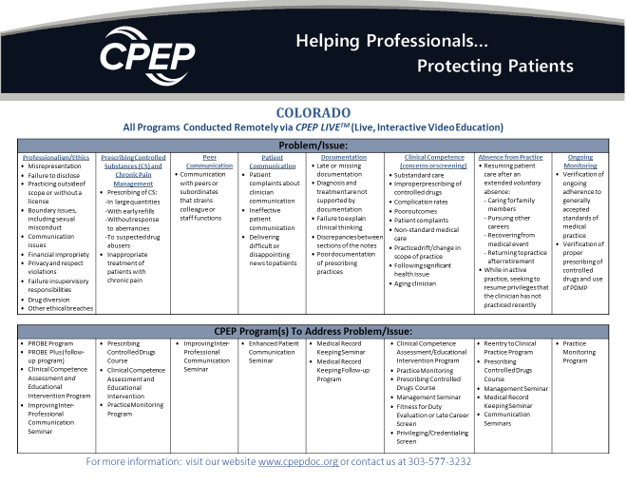

Slide 6
Who pays?
For Assessment, hospital may pay a portion or all of cost
For Seminars, participant usually pays
Tip from the field: Reimburse participant if achieves and maintains improvement over time

Slide 7
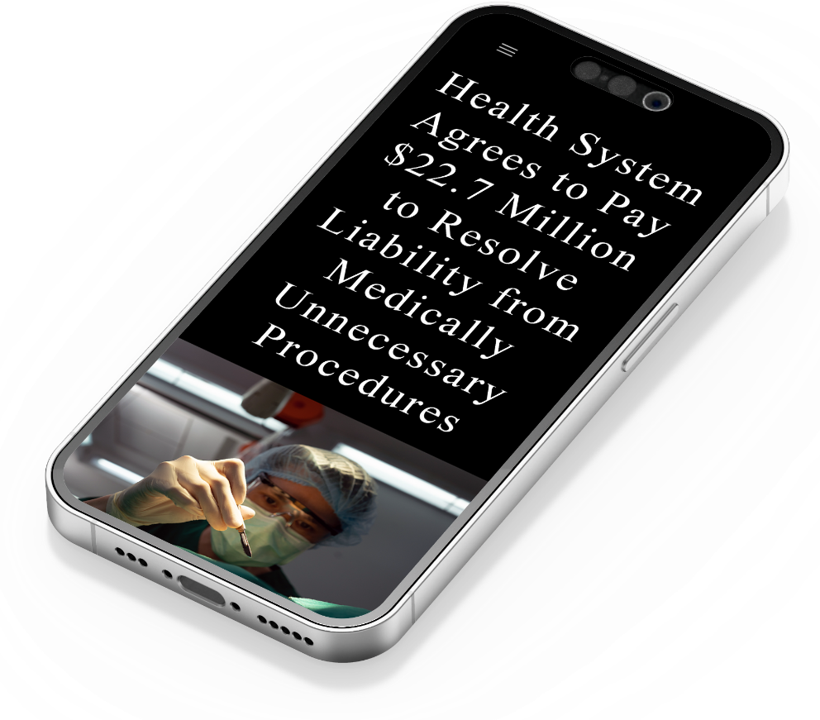
Medical personal reported concerns about 2 neurosurgeons to hospital:
Safety of patients was endangered
Surgeries resulted in excessive level of complications and negative outcomes
Performed surgery on patients who were not appropriate for surgery
Failed to properly document their procedures and outcomes
Hospital allowed both doctors to resign while on administrative leave
Did not report to NPDB or State Board
Failed to ensure that Dr. A and Dr. B were performing safe and medically-appropriate surgery procedures, despite repeated warnings, and put patients’ lives and safety at serious risk.
Decision not to report Dr. A or Dr. B to federal or state medical oversight bodies allowed both surgeons to simply resign and then continue to endanger patients at other hospitals.
United States Attorney’s Office Eastern District Washington April 12, 2022

Slide 8
BY DAVE COLLINS
Published 4:07 PM MDT, July 15, 2021
Six female physicians alleged that a male physician grabbed them and kissed them against their will and repeatedly touched them without consent
Filed a lawsuit alleging that:
The physician made inappropriate comments about their bodies
The physician retaliated against them including making false claims about their job performance
The officials at Yale refused to discipline the physician despite repeated complaints.
Yale hired the physician after he left two other institutions amid similar allegations
Yale reached a confidential settlement with the women

Slide 9
What are the Potential Consequences of Unaddressed Performance Concerns in the Healthcare Setting?
Risk of poor clinical outcomes or patient harm
INCREASED staff turnover
Poor
MORALE
LAW-SUITS
Perpetuation of a culture of tolerance

Slide 10
When Can CPEP Help?
Under Review
Fine tuning
Cup of coffee chat

Slide 11
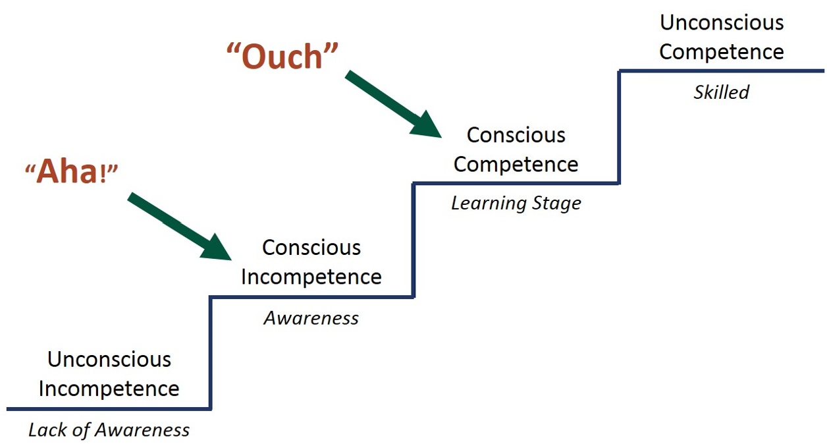

Slide 12
Ways to Intervene
Assessments and Educational Intervention
Skill-building Seminars Professionalism, Communication, Documentation, Prescribing Controlled Drugs

Slide 13
Types of Assessments
Clinical Competence
Questions about clinical performance
Reentry to Clinical Practice
Requesting privileges after a break from practice (for non-disciplinary reasons)
Credentialling Screen
Does not meet specific credentialling or privileging requirements
Aging Clinician Fitness for Duty
Concerns about performance in older clinicians
NEW: Streamlined Program!
Provide Re-eligibility Programs for a number of ABMS Boards

Slide 14
Competence Assessment and Structured Educational Intervention: Long-term Impact on Quality of Care
(N=2073 charts reviewed)
Percent of Charts in which
Care Failed to Meet Generally Accepted Standards
Charts submitted by Assessment & Education “alumni” were
5.49 times less likely to indicate care that failed to meet generally accepted standards
than those submitted by physicians who did not complete assessment and education (completed practice monitoring only)
P<.0001
JOURNAL of MEDICAL REGULATION VOL 108, NO 1 | 7
Notes:
statistically significant relative risk for problematic documentation and substandard care among physicians
an effective means of improving physician performance and that improvement is sustained after completion of the Education Program
Some in monitoring only might benefit from intervention

Slide 15
Skill-building Seminars
PROBE – Professionalism, Boundaries & Ethics
Improving Interprofessional Communication Seminar
Enhancing Patient Communication Seminar
Medical Recordkeeping Seminar
Prescribing Controlled Drugs Course

Slide 16
Change is a Process – Not an Event
Program | Follow-up
Assessment | Education Plan - 6-12 mths
Record Keeping | PIP - 6 mths
Inter-professional Communication | Coaching - 6 sessions
Clinician-Patient Communication | Coaching - 6 sessions
PROBE Program | PROBE Plus - 6 mths
Follow-up programs focus on
Applying new knowledge to practice
Implementing and maintaining change over time
Provide support and accountability for participants after the intervention
Enrollment is optional – include in agreement

Slide 17
Case Study: Improving Inter-Professional Communication
Orthopedic surgeon, referred by MEC
Several nurses and other staff members filed complaints that his communication style was:
Intimidating
Demeaning
Humiliating
Tends to lecture and staff are apprehensive to call him with patient concerns, jeopardizing patient safety

Slide 18
Case Study: Improving Inter-Professional Communication
In seminar
Indicated he has high expectations of himself and others; strong desire to control outcomes leading to a struggle to share responsibility – just wants to take charge
Engaged and attentive throughout the seminar, displayed clear self-reflection
Created Action Plan
Improve communication with staff to improve patient care and outcomes
Improve his response to frustration in the workplace
Improve his work/life balance
Conversation with CMO at referring hospital
“The seminar was life-changing for Dr. X”
“He’s still a raging beast inside, but is able to maintain perspective and control”
“Became a mediator in a dispute between two other physicians”
“You know it’s bad when I’m the peacekeeper in the room”

Slide 19
Case Study #5
Dr. Merlot is an Ob/Gyn who was called in to attend a delivery 12:30 AM.
Personnel suspected she was under the influence of alcohol.
When confronted, she admitted she had consumed wine prior to coming to the hospital (She originally said it was 2 glasses of wine and then admitted it was 1.5 bottles)
She was suspended and entered a treatment program
After a six-month absence, Dr. Merlot asked to have her privileges reinstated.
Hospital required her to continue in compliance with PHP and complete PROBE

Slide 20
Case Study #5
Final Essay
“I was accused of unprofessional conduct posing a serious risk to patient safety and failure to take responsibility or accountability for the amount of alcohol imbibed.”
“Were the allegations brought against me correct and just? Absolutely. Attending the Seminar helped me realize how many ethical violations I had committed.”
“I am once again humbled at the risks I took to both my patient but also to the integrity to myself and my profession.”
“During the course I felt I was taking a step back in my recovery, but further reflection makes me realize that as painful as it was, I did make those steps forward in order for me to recognize the full impact of my mistakes.”

Slide 21
Case Study #5
Final Essay
“I was accused of unprofessional conduct posing a serious risk to patient safety and failure to take responsibility or accountability for the amount of alcohol imbibed.”
“Were the allegations brought against me correct and just? Absolutely. Attending the Seminar helped me realize how many ethical violations I had committed.”
“I am once again humbled at the risks I took to both my patient but also to the integrity to myself and my profession.”
“During the course I felt I was taking a step back in my recovery, but further reflection makes me realize that as painful as it was, I did make those steps forward in order for me to recognize the full impact of my mistakes.”
PASS

Slide 22
Case Study: Low/No Volume OB/GYN
OB/GYN out of practice for 1 year to care for a family member; cut back on practice prior to leaving
Hired by hospital-based OB practice; hospital has critical need for her to start work ASAP
Gap in practicing is preventing her from being privileged due to no recent clinical activity

Slide 23
Case Study: Low/No Volume OB/GYN
Skills assessment:
Delivery Simulation; Structured Clinical Interview; Fetal Monitor Strip Interpretation
Findings:
Ready to assume the described skills, with the exception of limited areas where she acknowledged she lacked skills and needed further training
Recommendations:
Complete FMS interpretation review course
Oversight in labor setting focused on recognizing acute presentations on FMS and labor management
Pursue hands on training in areas listed to gain privileges
OUTCOME: Resumed practice with initial supervision of delivery management; successfully practicing
Notes:
4 privileges where she acknowledged the need for more training – didn’t receive those

Slide 24
Questions?
Feel free to contact me if you have any questions!
Beth Korinek
bkorinek@cpepdoc.org
303-577-3232 x 0
www.cpepdoc.org

Slide 25
